Slide 1
EUROPCAR
Privilege Program
Product Manager – Strategic Intelligence based on Customer Experience
Strategy · Consumer Behaviour · Competitive Intelligence · A/B Testing · Roadmap

Slide 2
PROJECT OVERVIEW
Table of Contents
01
Business Objectives & Challenges
05
Cultural Intelligence Map
02
SWOT Analysis – Privilege Program
06
A/B Testing Strategy & Roadmap
03
Competitor Analysis
07
Success Stories & KPIs
04
Consumer Behaviour & Psychology
08
Strategic Recommendations

Slide 3
01 | Business Objectives & Challenges
BUSINESS OBJECTIVES
CHALLENGES
Increase Average Order Value (AOV)
Price Sensitivity among target segments
Increase Online Conversion Rate
High Cart & Booking Abandonment Rates
Improve User Experience across digital channels
Navigation Complexity & Page Load Speed
Reduce Customer Acquisition Costs
Ineffective Audience Targeting

Slide 4
02 | SWOT Analysis – Europcar Privilege Program
STRENGTHS
WEAKNESSES
Tier-based structure (Club → Elite VIP) with clear progression
Free weekend rentals & complimentary upgrades
Seamless digital access via mobile app
Partnership with Accor Hotels & Priority Pass
Benefits vary significantly across regions
Limited partnerships vs. competitors
Low member awareness & benefit underutilisation
No airline integration reducing perceived value
OPPORTUNITIES
THREATS
Expand global partnerships (airlines, hotels, platforms)
Leverage AI for personalised rewards & communications
Eco-friendly rewards for sustainability-conscious customers
Promotional campaigns to boost programme awareness
Intense competition: Hertz Gold Plus, Avis Preferred, Sixt
Economic downturns reducing rental frequency
Rapid technology advances in competitor programmes
New entrants with disruptive subscription-based models

Slide 5
03 | Competitor Analysis – Loyalty Programme Benchmarking
ASPECT | Europcar Privilege | Hertz Gold Plus | Avis Preferred | Sixt Loyalty
Membership Tiers | Club, Executive, Elite, Elite VIP | Gold, Five Star, President Circle | Preferred, Preferred Plus, President | Sixt Express, Gold, Platinum, Diamond
Key Benefits | Free weekend rentals, upgrades, express checkout | Points-based free rentals, car upgrades | Points redemption, priority service | Guaranteed upgrades, exclusive hotline
Partnerships | Accor Hotels, Priority Pass | Delta, United, Marriott, Hilton | Airlines, hotels, travel agencies | Major airlines, luxury travel partners
Global Reach | Strong Europe, moderate global | Global presence | Strong Americas & Europe | Strong Europe, expanding globally
Personalisation | Limited AI-driven | Highly personalised (customer profile) | Moderate (rental history) | Strong focus on premium customers
Sustainability | None tied to loyalty | EV rental focus | Limited focus | Sustainable rental options
Digital Experience | Seamless tracking & rewards app | Comprehensive app, advanced features | Basic app functionality | Advanced app for business travelers

Slide 6
04 | Consumer Behaviour & Psychological Principles
Integrating psychology into the Privilege Programme to drive engagement, loyalty, and member satisfaction.
Behavioral Conditioning
Self-Determination Theory
Analyse rental patterns to offer personalised rewards, reinforcing repeat bookings.
CRM tools personalise experiences around autonomy, competence & relatedness ,making members feel valued.
Social Identity
Cognitive Dissonance
Showcase testimonials to create community belonging and aspirational tier progression.
Ensure members feel validated in choosing Europcar, reducing post-purchase doubt.
Feedback Loop
Elaboration Likelihood
Real-time feedback systems improve responsiveness and member satisfaction dynamically.
Clear benefit communications drive central (thoughtful) information processing — not peripheral.

Slide 7
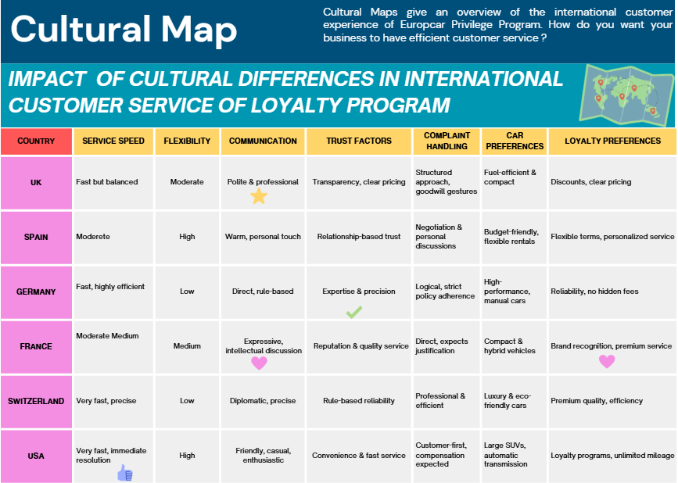

Slide 8
05 | Cultural Intelligence Map – International Customer Service
🇬🇧 UK
🇪🇸 Spain
Action Item: Transparent pricing, courteous service, occasional goodwill gestures.
Action Item: Warm, flexible approach with personalised offers and relationship-building.
🇩🇪 Germany
🇫🇷 France
Action Item: Strict policy adherence, technical accuracy, minimal small talk.
Action Item: Engaging discussions, logical policy justification, brand reputation emphasis.
🇨🇭 Switzerland
🇺🇸 USA
Action Item: Premium, efficient service with precision and rule-based transparency.
Action Item: Fast resolution, convenience priority, and robust loyalty rewards programmes.

Slide 9
06 | A/B Testing Strategy & Optimisation
Tool: A/B Testing tool | A/B Testing, Feature Flags, Personalisation & Predictive Targeting Platform
01
02
03
04
05
06
Objective ID
Audience Segmentation
Variation Creation
Experimentation Launch
Simulation & Analytics
Implement Winner
Define hypothesis & KPIs: CTR, conversion rate, time on site >600s, visits.
Classify audience by visits, page views, website exit patterns for precise targeting.
Build 2 versions (Original vs. Variation) for data comparison and insights.
Run A/B tests exposing segmented audiences to different variations.
Graphical KPI reporting and simulation analysis of variation effects.
Roll out winning variation across the site after data-driven assessment.
KPIs monitored: Click Through Rate · Time on Site > 600s · Conversion Rate · Number of Visits · Cross-sell Rate · Campaign ROI

Slide 10
06b | A/B Testing Use Cases – Europcar Privilege
Booking Funnel
Landing Pages
Redesign form fields & reduce friction in payment step
Personalize post login landing page for new vs. returning Privilege members
Expected: ↑ Booking completion rate, ↓ abandonment
Expected: ↑ CTR, ↑ session depth for returning members
Discount Targeting
CTA Optimisation
Show upgrade or add-on offers only to members showing active booking intent (searched dates, viewed vehicles, or abandoned checkout)
Test CTA button colour, CTA copy ('Redeem Now' vs. 'Claim Your Benefit')
Expected: ↑ ROI x3 (validated by loyalty industry benchmark)
Expected: ↑ Click-through rate on rewards page
Loyalty Tier Upsell
Personalised Emails
Widget showing points gap to next tier at checkout
Tier-personalised reward emails (dynamic points balance + next tier gap) vs. standard member communications
Expected: ↑ Average Order Value, ↑ tier upgrade rate
Expected: ↑ Email open rate, ↑ revenue per email

Slide 11
07a | Customer Journey & Key Touchpoints
Brand Awareness
Exploration
Decision
Purchase
Loyalty
Website / App
Customer Interactions
Product Selection
Checkout
Post-Purchase
Personalised landing pages, brand discovery
UX design, wishlist, personalised recommendations
Display size, colour, offers, financing options
Seamless checkout, order confirmation
Rewards, brand advocacy, repeat purchase
71%
58%
83%
38%
68%
Travel loyalty members first engage with a programme via the brand's website or app before joining
Frequent business travellers compare loyalty tier benefits before committing to a rental provider
loyalty members say exclusive member rates or upgrade offers directly influence their booking decision
Loyalty programme drop-offs occur at checkout due to friction or points redemption confusion
Privilege-tier members who receive personalised post-rental communication make a repeat booking within 90 days
Sources: Phocuswright,GBTA,McKinsey,

Slide 12
07b | Benchmark Success Stories – A/B Testing in Action
x3
+50%
+15%
+30%
ROI on Targeted Promotions
Revenue vs. Untargeted Campaigns
Conversion Rate Improvement
Cross-Sell Increase
Travel loyalty benchmark : intent-based targeting
Personalisation vs generic campaigns
Via targeted A/B experimentation
Precision audience segmentation- Tier Match
""Experimentation is at the core of how we improve — every change we make to the customer experience is validated through data before full rollout."
- Booking.com Product Team, Growth & Experimentation
" "A/B testing our loyalty communications reduced churn by double digits and increased redemption rates significantly."
- Head of CRM, European Travel Group

Slide 13
08 | Strategic Actions
HIGH
HIGH
Personalisation
Expand Partnership Ecosystem
Deploy predictive AI engine & customer service to deliver individualised rewards, communications and booking funnel experiences by member tier level and rental behaviour.
Integrate airline loyalty programmes (Air France, BA, Lufthansa) and hotel chains beyond Accor to compete with Hertz/Avis alliances.
MED
MED
Eco-Friendly Reward Tracks
Continuous A/B Testing Programme
Introduce a sustainability tier within Privilege (e.g., EV rental bonus points) to capture the growing green-travel segment.
Run structured experimentation cycles on booking funnel, loyalty dashboard UX and coupon targeting — piloting with KPIs: CTR, conversion rate, AOV.
LOW
LOW
Cultural Service Localisation
Member Awareness Campaign
Tailor customer service scripts and reward mechanics to country-specific cultural expectations (UK, Germany, France, USA, Spain, Switzerland).
Address low benefit awareness with targeted onboarding emails and in-app benefit highlights, reducing underutilisation across all tiers.

